Slide 1

DIGITAL LOGIC DESIGN (111776)
Dr. Owais Hussain

Slide 2
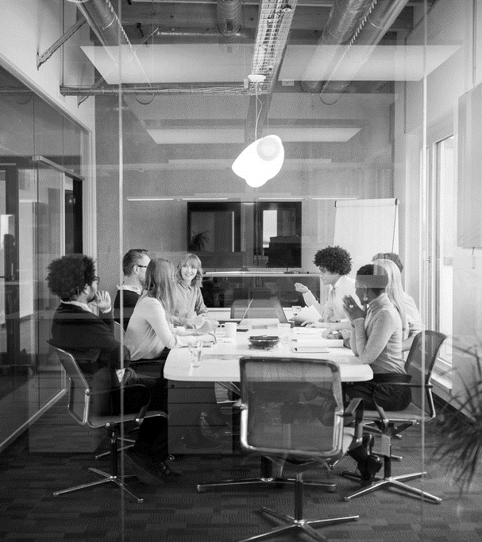
Agenda
Decimal Number
Binary Numbers
Octal, Hexadecimal, and more
Activity
Binary Arithmetic
Floating Point Numbers
Logic Gates
NAND as Universal Gate

Slide 3
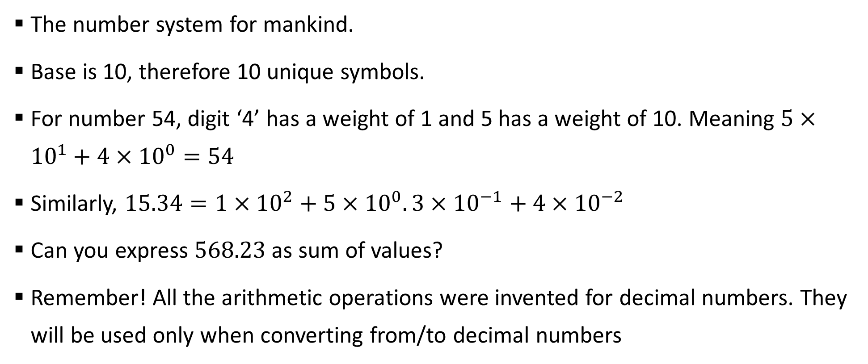
Sample 2
Decimal Numbers
The number system for mankind.
Base is 10, therefore 10 unique symbols.
For number 54, digit ‘4’ has a weight of 1 and 5 has a weight of 10. Meaning $5×{10}^{1}+4×{10}^{0}=54$
Similarly, $15.34=1×{10}^{2}+5×{10}^{0}.3×{10}^{−1}+4×{10}^{−2}$
Can you express $568.23$ as sum of values?
Remember! All the arithmetic operations were invented for decimal numbers. They will be used only when converting from/to decimal numbers
Notes:
Count the number of fingers. That’s probably the primary intuition behind decimal system.

Slide 4
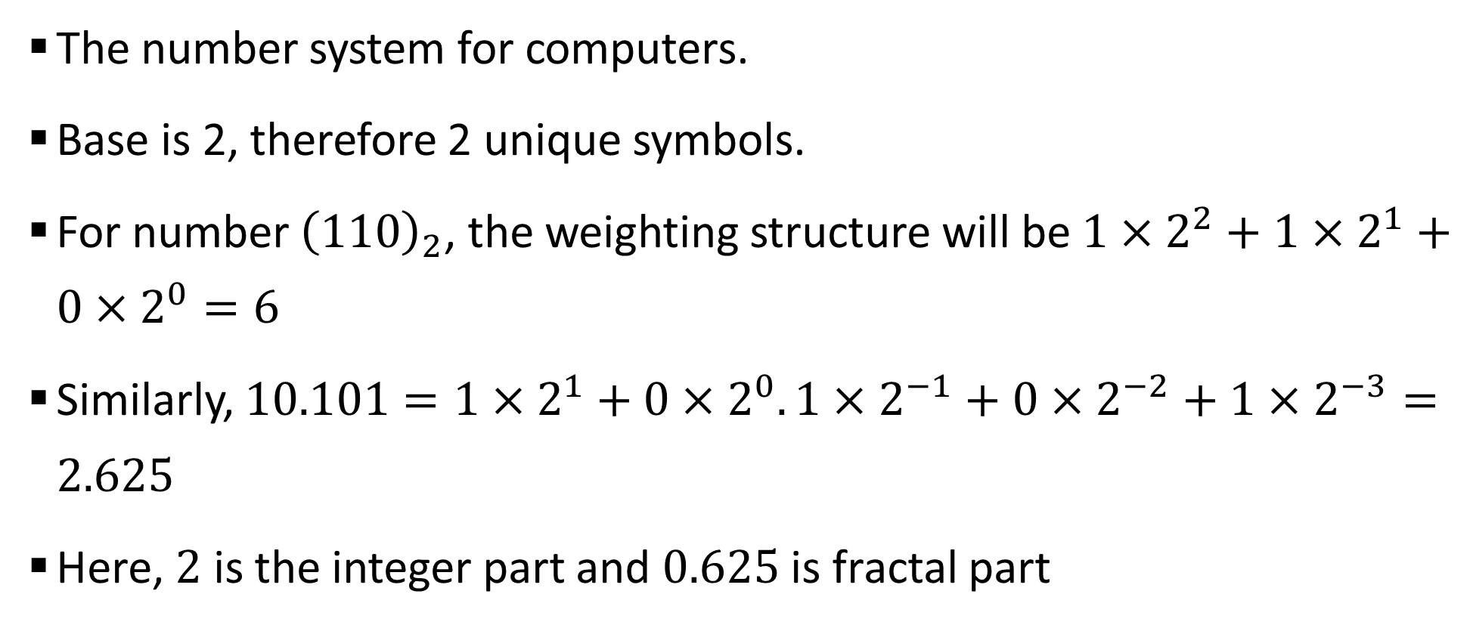
Sample 2
Binary Numbers
The number system for computers.
Base is 2, therefore 2 unique symbols.
For number ${\left(110\right)}_{2}$, the weighting structure will be $1×2^{2}+1×2^{1}+0×2^{0}=6$
Similarly, $10.101=1×2^{1}+0×2^{0}.1×2^{−1}+0×2^{−2}+1×2^{−3}=2.625$
Here, $2$ is the integer part and $0.625$ is fractal part

Slide 5
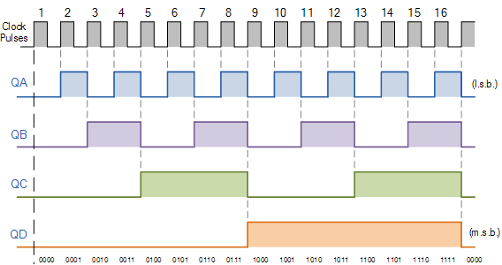
Sample 2
Binary Numbers – Waveform

Slide 6
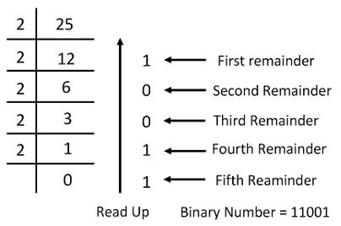
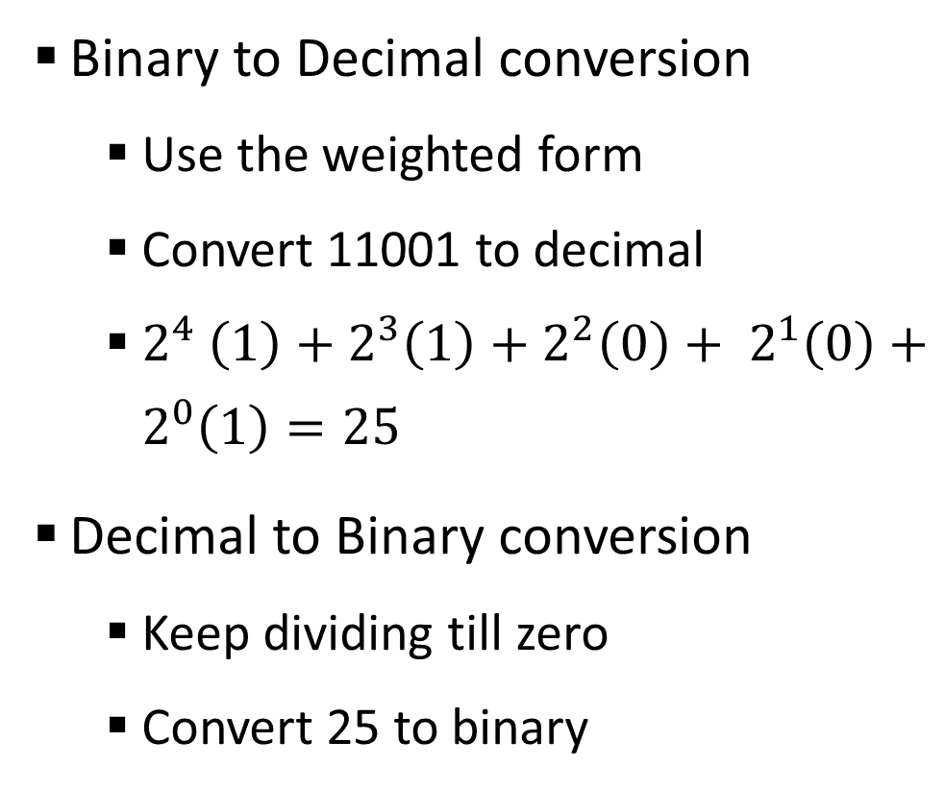
Sample 2
Binary Numbers
Binary to Decimal conversion
Use the weighted form
Convert 11001 to decimal
$2^{4} \left(1\right)+2^{3}\left(1\right)+2^{2}\left(0\right)+ 2^{1}\left(0\right)+2^{0}\left(1\right)=25$
Decimal to Binary conversion
Keep dividing till zero
Convert 25 to binary

Slide 7
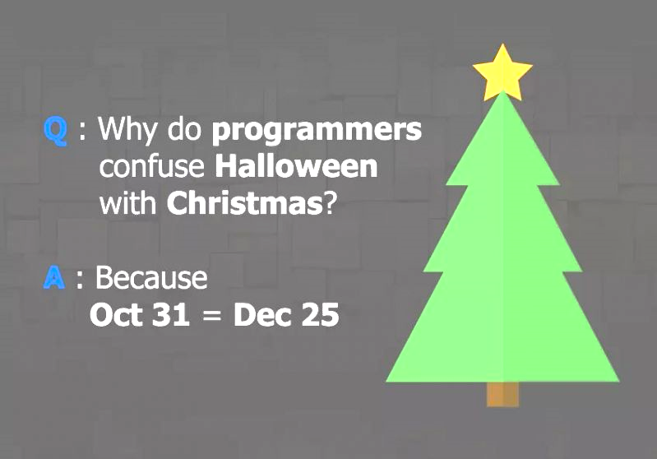
Sample 2
Octal and Hexadecimal Numbers
Octal has base 8, therefore 8 unique symbols
But why are they even needed?
Occupy all numbers that can be stored in 3 bits
Simple, closest to denary number systems (no alphabets)
Sometimes saves memory, for example in UNIX file permissions
7 Colours of prism can be given octal codes
Day of week can be represented in octal number system
Can you come up with anything else which can be represented in octal?
Notes:
The limitation of decimal is that it requires 4 bits, but does not use it all up. So for optimal use of bits, the preferred ones are Octal and Hexadecimal

Slide 8
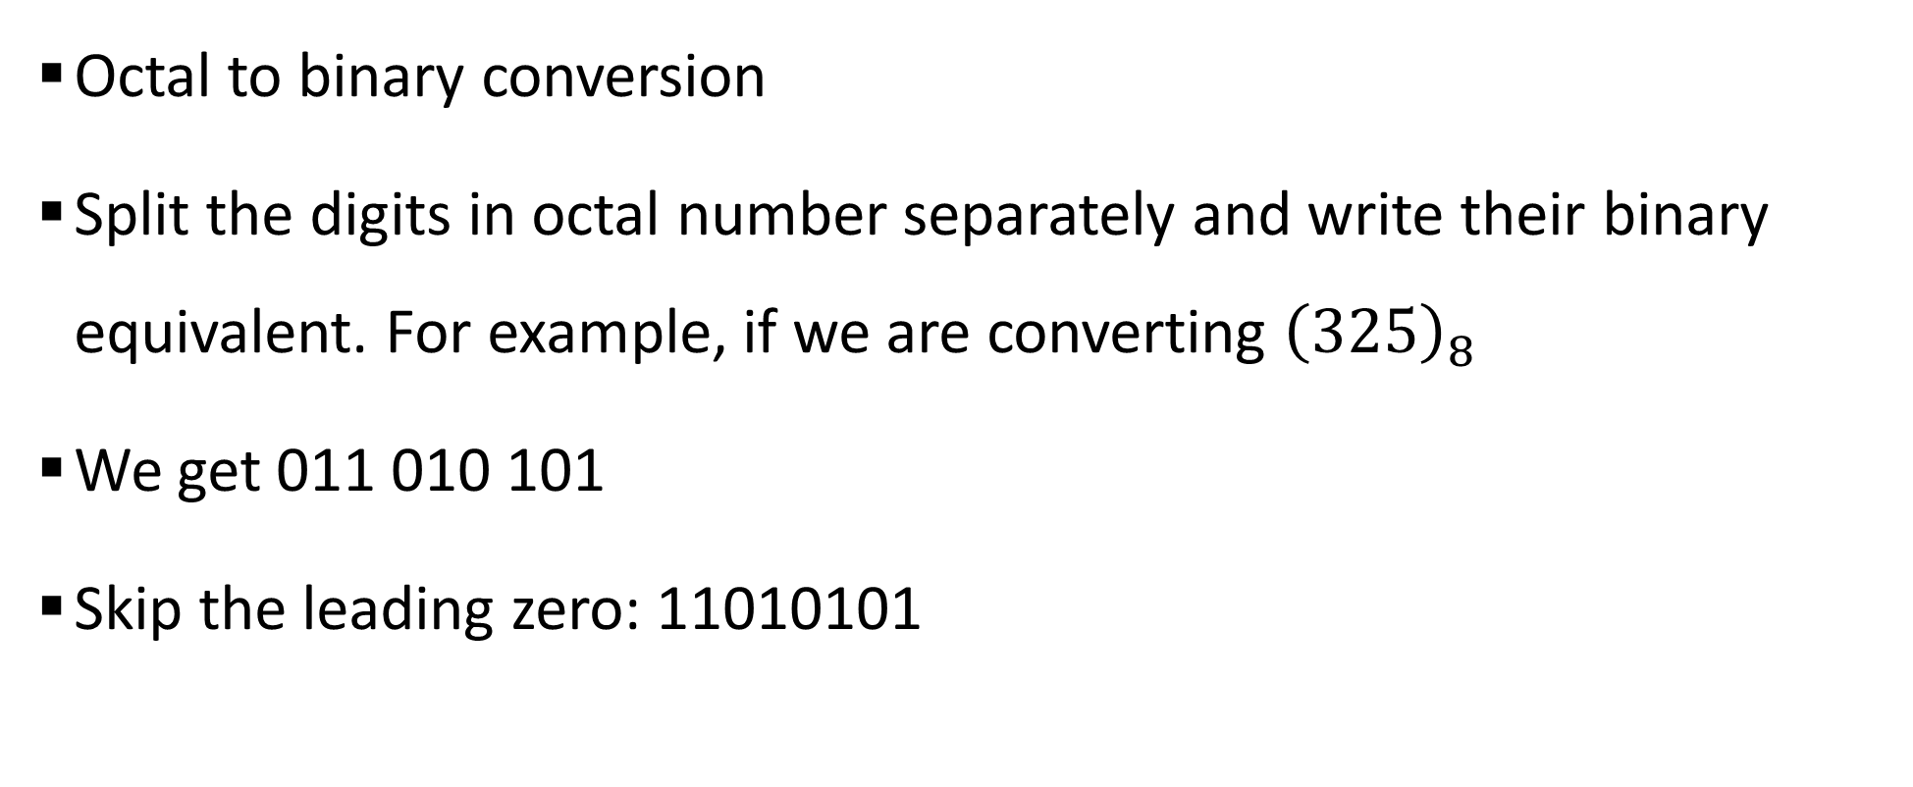
Sample 2
Octal and Hexadecimal Numbers
Octal to binary conversion
Split the digits in octal number separately and write their binary equivalent. For example, if we are converting ${\left(325\right)}_{8}$
We get 011 010 101
Skip the leading zero: 11010101
325₈
3
2
5
011
010
101

Slide 9
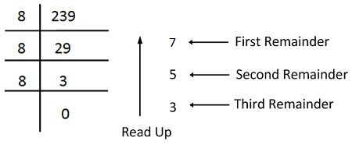
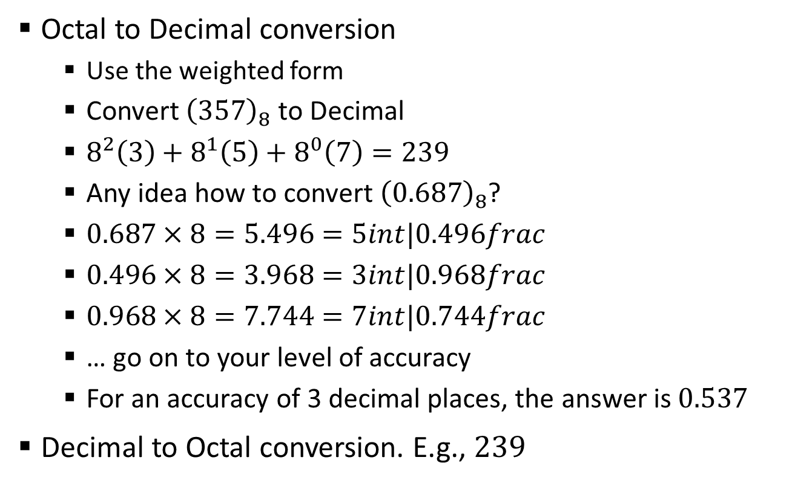
Sample 2
Octal and Hexadecimal Numbers
Octal to Decimal conversion
Use the weighted form
Convert ${\left(357\right)}_{8}$ to Decimal
$8^{2}\left(3\right)+8^{1}\left(5\right)+8^{0}\left(7\right)=239$
Any idea how to convert ${\left(0.687\right)}_{8}$?
$0.687×8=5.496=5int|0.496frac$
$0.496×8=3.968=3int|0.968frac$
$0.968×8=7.744=7int|0.744frac$
… go on to your level of accuracy
For an accuracy of 3 decimal places, the answer is $0.537$
Decimal to Octal conversion. E.g., $239$

Slide 10
Sample 2
Octal and Hexadecimal Numbers
Hexa-decimal has a base of 16, therefore 16 unique symbols
Occupy all possible numbers that can be stored in 4 bits
Save memory:
Remember one byte has 8 bits (binary digits)
In 8 bits, we can store 2 hexadecimal numbers = 256 values
In 8 bits, we can store 2 denary numbers = 100 values
Uses:
ASCII (American Standard Code for Information Interchange) characters
Colour codes
MAC addresses
Can you mention another use case?
Notes:
Data compression is another use case

Slide 11
Sample 2
Activity 1
Convert your current CGPA into Binary, Octal, Hexadecimal numbers
Then convert the answers back again into Decimal.
Invent an imaginary number system with a base of 32.
Write down all unique symbols you’ll use.
Convert your Mobile phone number into your imaginary number system.
Then convert the answer back to Binary value.

Slide 12
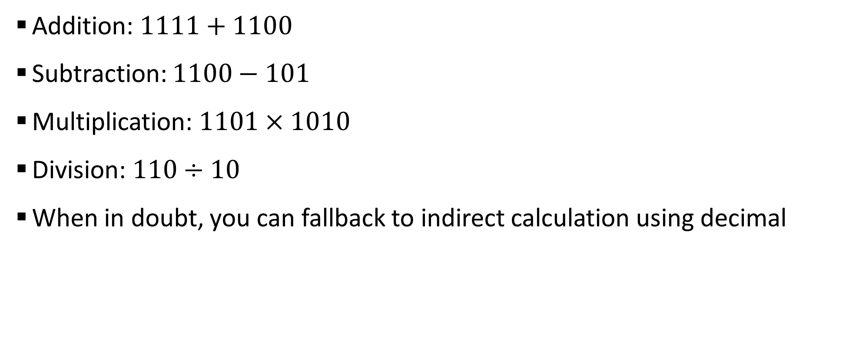
Sample 2
Binary Arithmetic
Addition: $1111+1100$
Subtraction: $1100−101$
Multiplication: $1101×1010$
Division: $110÷10$
When in doubt, you can fallback to indirect calculation using decimal

Slide 13
Sample 2
Binary Arithmetic
Complement method are important as they can be used to represent negative numbers.
Used when there is no minus sign available
1’s complement:
Change all 1’s to 0’s and all 0’s to 1’s (inverters or NOT circuits)
The result is negative representation of the input number
Convert 1101001 into its 1’s complement form
2’s complement = 1’s complement + 1
Notes:
1101001 will become 0010110
If nobody asks what happens if the input is 00000000, then ask them back why you think zero should be represented as negative or positive?

Slide 14
Sample 2
Binary Arithmetic
Sign bit for negative representation
The drawback of sign bit
Why languages have unsigned data types?
00011001 has a positive sign and value 11001
Represent the ASCII code of your blood group as a signed binary number
Notes:
1101001 will become 0010110

Slide 15
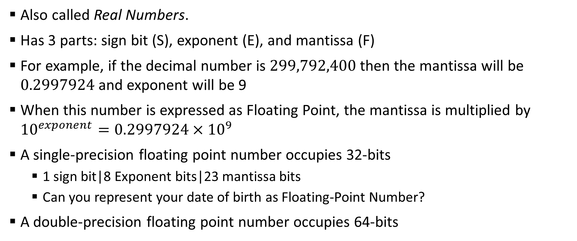
Sample 2
Floating Point Numbers
Also called Real Numbers.
Has 3 parts: sign bit (S), exponent (E), and mantissa (F)
For example, if the decimal number is $299,792,400$ then the mantissa will be $0.2997924$ and exponent will be 9
When this number is expressed as Floating Point, the mantissa is multiplied by ${10}^{exponent}=0.2997924×{10}^{9}$
A single-precision floating point number occupies 32-bits
1 sign bit|8 Exponent bits|23 mantissa bits
Can you represent your date of birth as Floating-Point Number?
A double-precision floating point number occupies 64-bits
Notes:
Talk about Steve Jobb’s and Bill Gates’s interview and how DOS had an edge over IBM as it used floating point instead of fixed point
This value $299,792,400$ is the speed of light
Fact! CPU’s now have a separate unit called FPU dedicated for calculations of floating points. This is to increase performance.

Slide 16
Sample 2
Logic Gates or Logic Circuits or Logic Functions
Basic Gates
Symbolic Representation
Extended Gates
NAND
NOR
XOR and XNOR
XAND and XNAND
Waveforms
Truth Table
Timing Diagram

Slide 17

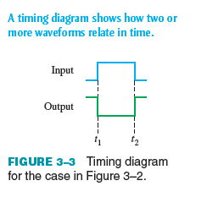
Sample 2
Logic Gates - Inverter
Inverter or NOT gate
Function: to invert the input value
Symbol
Truth Table
Waveform
Timing Diagram
Timing Diagram of 1011
1’s compliment circuit as application

Slide 18
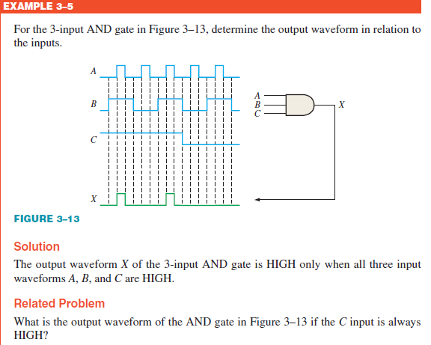
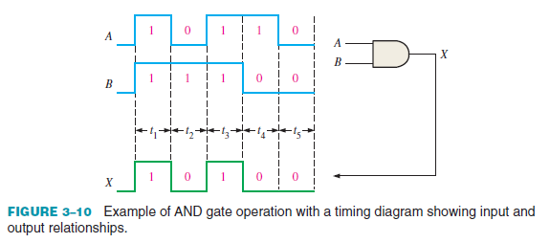
Sample 2
Logic Gates - AND
AND gate
Function: true if all are true
Symbol
10110 AND 11100
Truth Table
Waveform
Timing Diagram
3-input AND gate

Slide 19
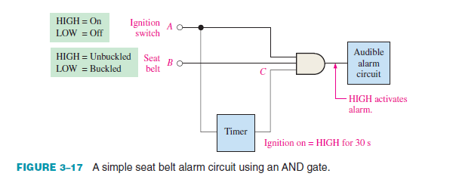
Sample 2
Logic Gates – AND application

Slide 20
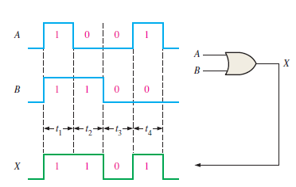
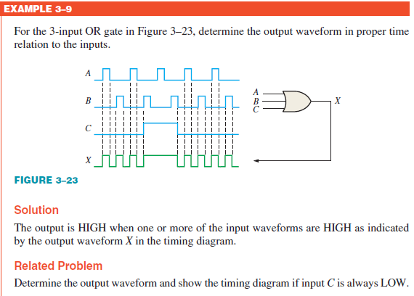
Sample 2
Logic Gates - OR
OR gate
Function: true if any is true
Symbol
1001 OR 1100
Truth Table
Waveform
Timing Diagram
3-input OR gate

Slide 21
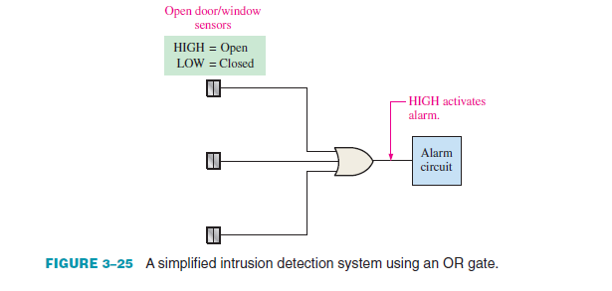
Sample 2
Logic Gates – OR application

Slide 22
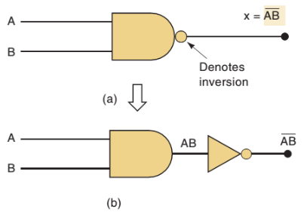
Sample 2
Logic Gates - NAND
NAND gate – NOT-AND gate
Function: false if all are true
Symbol
10110 NAND 11100
Truth Table; Waveform; Timing Diagram
3-input NAND gate

Slide 23
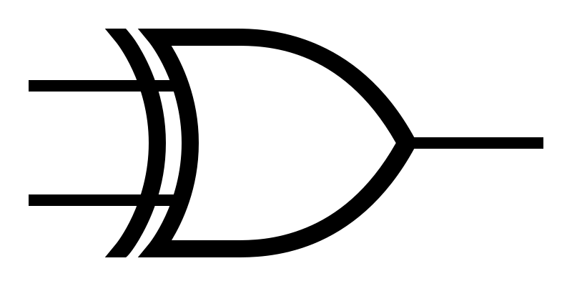
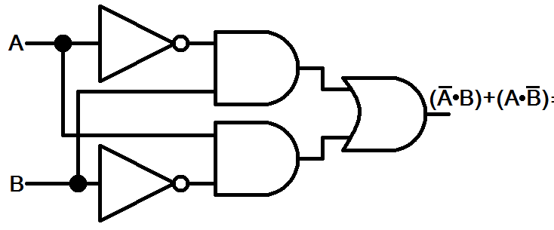
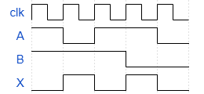
Sample 2
Logic Gates - XOR
XOR gate – Exclusive OR gate
Function: any but not all
Symbol
10110 XOR 11100
Truth Table; Waveform; Timing Diagram
3-input XOR gate?!
A | B | A XOR B
0 | 0 | 0
1 | 0 | 1
0 | 1 | 1
0 | 1 | 0

Slide 24
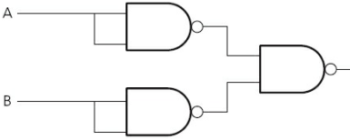
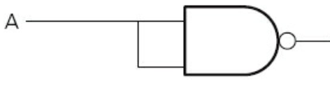

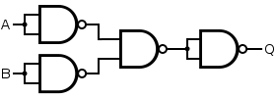
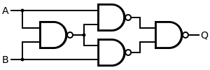
Sample 2
NAND as Universal Gate
NAND as Universal gate
NOT
AND
OR
NOR
XOR
How would you make XNOR?
Notes:
Using NAND as universal gate is a business decision, which helps chip manufacturers to get a single chip in bulk and use it for any purpose without worrying about supply and demand gap.

Slide 25
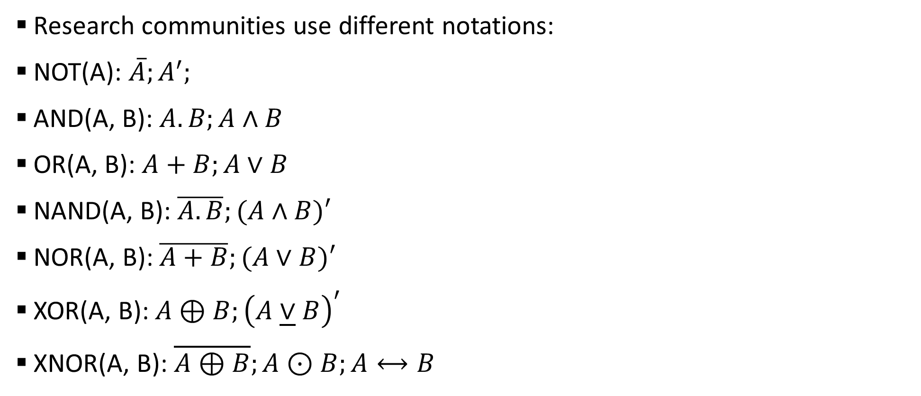
Sample 2
Logic Gates - Notations
Research communities use different notations:
NOT(A): $\overline{A};A^{′};$
AND(A, B): $A.B;A∧B$
OR(A, B): $A+B;A∨B$
NAND(A, B): $\overline{A.B};(A∧B)′$
NOR(A, B): $\overline{A+B};(A∨B)′$
XOR(A, B): $A⊕B;{\left(A\underline{∨}B\right)}^{′}$
XNOR(A, B): $\overline{A⊕B};A⊙B;A⟷B$

Slide 26



THANK YOU
Owais Hussain
+92 345-3174270
owais.hussain@kiet.edu.pk
https://www.researchgate.net/profile/Owais-Hussain-3

